Slide 1
Theories of Production and Cost analyses
Unit - II

Slide 2
UNIT II
Theories of Production and Cost Analyses: Theories of Production function- Law of Variable proportions-Isoquants and Isocosts and choice of least cost factor combination-Concepts of Returns to scale and Economies of scale-Different cost concepts: opportunity costs, explicit and implicit costs Fixed costs, Variable Costs and Total costs –Cost –Volume-Profit analysis-Determination of Breakeven point(problems)-Managerial significance and limitations of Breakeven point.

Slide 3
MEANING OF PRODUCTION
Production means a process to change the raw materials into final goods (or) finished goods.
But in economics making of the goods (or) creation of goods (material and immaterial) for the purpose of selling them in the market is called production.
Production is the result of the collective efforts of the four factors of production land, labour, capital and organization

Slide 4
FACTORS OF PRODUCTION AND ITS CLASSIFICATION
Land:
Land in common usage is soil or surface of the earth. As a factor of production it refers to all natural resources like forests, water, climate, minerals etc. It mainly supplies food to people, provides space for work and supplies raw material to industry.
Labour
In the ordinary usage, labour stands for only physical labour. In economics, labour means physical as well as mental services engaged in production to earn income. Classical economists and Karl Marx have considered labour as the sole factor of production.
Capital:
In the ordinary sense capital means money for an individual or a firm. Money is a form of capital when it is used to purchase machinery, tools, raw materials etc. Ultimately it is these man made goods i.e. Machinery, tools etc. that help in the production of goods. These are vital in raising productivity in different sectors.
Entrepreneur:
The person who organizes the production is called an entrepreneur. He is considered as a separate factor because he performs specific functions different from those of other factors. Now-a-days an entrepreneur is not considered as a separate factor but as special types of human labourer. Whenever the ownership and the management are one and the same entrepreneur has to perform certain specific functions.

Slide 5
Production function
Production function explains the functional relationship between inputs and output. To get a certain amount of output what combination of inputs are required will be given by the production function. For example
Q = f ( K, N, L ........ E )
Where, Q = output
f = Function
K = Capital
N = Labour
L = Land
E = Other inputs

Slide 6
Assumptions of Production function
1. The level of technology remains constant.
2. The production function relates to a particular period.
3. The factors of production are divided into small.
4. The firm uses the best and most efficient technique.
To construct a builiding what combinations of inputs are required are given by engineers and economists make assumptions through deductive logic formulated theories and arrive at a meaningful conclusions.

Slide 7
Managerial uses of Production function
a. Helpful in determining least cost combination.
b. It helps to determine optimum level of output.
c. Useful in drafting plans.
d. Supports in taking cost control decisions.

Slide 8
Types of production functions:
Before analyzing the types of production-function it will be useful to understand the meaning of following important terms
1. Short period production functions:
It shows the relationship between production and factors of production in the short period. In the short period all factors may not be available, so the factors of production in the short period can be divided into two types they are:-
1. Fixed factors
2. Variable factors

Slide 9
1. Fixed factors:
The factors which are not available in the short period they can be kept as constant. So they are called fixed factors.
Example: land, building, machines etc.
2. Variable factors:
The factors which are available to change the output in the short period, they can be changed so they are called variable factors
Example: capital, labour, raw materials etc.
2. Long period production function:
It explains the relationship between production and factors of production in the long period. It is also called as law of return to scale.
• The classification of fixed and variable factors is related to only short period. But in long period all factors are variable factors

Slide 10
LAW OF VARIABLE PROPORTION
Law of variable proportions (LVP) states that as we increase quantity of only one input keeping other inputs fixed, total product (TP) initially increases at an increasing rate, then at a decreasing rate and finally at a negative rate.
The changes in TP and MP (Marginal production) can be classified into following three phases:
Phase I : TP rises at increasing rate and MP increases
Phase II: TP rises at decreasing rate MP decreases and is positive
Phase III: TP falls MP becomes negative

Slide 11
It explains the relationship between inputs and outputs in the short period. According to this law output can be changed by changing some factors (variable factors) while other factors are constant. So it is called law of variable proportions. This law was developed by “Alfred Marshall”.
Definition:
“An increase in the amount of labour and capital applied in the cultivation of land causes in general a less than proportionate increase in the amount of output raised unless it happens to coincide with the improvements in the arts of agriculture”. – Marshall

Slide 12
Concepts in this law:
Total product:
(1) Total Product - It refers to the total output of the firm per period of time
(2) Average Product - Average Product is total output per unit of the variable input. Thus Average Product is total product divided by the number of units of the variable factor.
AP = Q/L where Q is Total Product, L is the quantity of labour.
(3) Marginal Product - Marginal Product is the change in total product resulting from using an additional unit of the variable factor.
MP = dQ/dL, where d is the rate of change
It is the total amount of the output obtained by the firm ‘or’ producer by the employment of total units of factors of production (labour). When the marginal productivities of labour added then total productivity can be obtained
TP = f [ql ] (or) TP = ∑mp

Slide 13
Average product:
It is the product per unit of labour when the total product is divided with no. of units of labour average product can be obtained.
TP
Ap = -------
L
Marginal Product:
It is an additional product obtained by the firm or producer by the employment of additional unit of labour or one more unit of labour. The change in the total product is also called marginal product.
∆TP
MP = ------
∆ L
MP = TP_{n} – TP_{n-1}

Slide 14
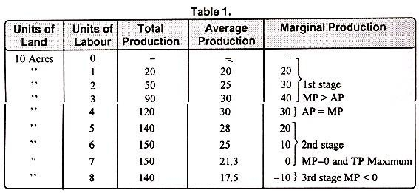
Explanation of the law Marshall explained this law with an example. He applied this law in the cultivation of land. According to this law when land is kept as constant and go on increasing the labour in the first stage increasing returns, second stage diminishing returns, and third stage negative returns are occurred. This can be explained by the following table. Units of labour Total product Average product Marginal product

Slide 15
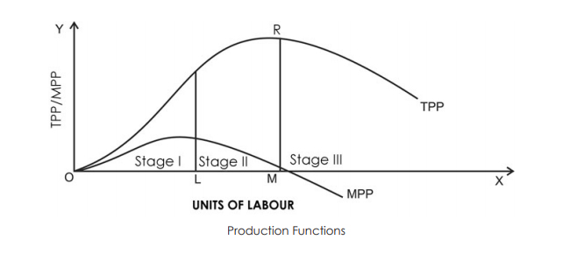
Diagrametic explaination

Slide 16
Main points in this law:
• In the 1st stage the T.P, A.P, M.P go on increasing but at the end of the 1st stage M.P starts to decline. The 1st stage was end when the M.P is equal to A.P.
• In the 2nd stage T.P goes on increasing but it increases with diminishing rate. A.P goes on diminishing.
M.P also goes on diminishing at the end of the 2nd stage the T.P reached the maximum. When the T.P is maximum then the M.P is zero. It intersects the x-axis.
• In the 3rd stage the T.P and A.P go on diminishing but for the M.P becomes negative so the M.P curves crossed the x-axis.
• The M.P curve intersects the A.P curve when the A.P is maximum

Slide 17
The law of variable proportions is also called “law of diminishing marginal returns”.
• This law is not only applicable to agriculture sector but also applicable to industrial sector, service sector etc.
Reasons for the diminishing returns:
• All units of variable factors are not homogenous.
• Imperfect substitutions.
• The combination becomes wrong.

Slide 18
Importance:
• This law is useful to firm (or) producer for the decision making regarding the output.
• According to this law the firm (or) producer operates only in second stage. He never chooses the either first stage (or) third stage.
Assumptions:
• The units of the variable factor are homogenous.
• There is a possibility to change the some factors (Variable factors), while other factors are constants (fixed factors).
• There is a possibility to change the combination of fixed and variable factors.
• There must be no change in the level of technology.
• It is applicable to only short period

Slide 19
Isoquants
Iso means equal and quant means quantity. i.e., equal quantity.
Irrespective of the labour and capital, equal quantity of output will be produced.
Therefore, an isoquant represents a constant quantity of output. The isoquant curve is also known as an “Equal Product Curve” or “Production Indifference Curve” or Iso-Product Curve.”
Production function for isoquants are Q= f(l,k)
Q = Quantity of the output produced by the company
f = function
l = labour
k = capital

Slide 20
Assumptions
Only 2 factors of production (Labour and Capital)
2 factors can substitute each other upto some limit
Irrespective of labour and capital, how many ever units they may be used quantity produced is the same.
(A given quantity of output may be produced with different combinations of factors. )

Slide 21
Assumptions:
The main assumptions of Iso-quant curves are as follows:
1. Two Factors of Production:
Only two factors are used to produce a commodity.
2. Divisible Factor:
Factors of production can be divided into small parts.
3. Constant Technique:
Technique of production is constant or is known before hand.
4. Possibility of Technical Substitution:
The substitution between the two factors is technically possible. That is, production function is of ‘variable proportion’ rather than fixed proportion.
5. Efficient Combinations:
Under the given technique, factors of production can be used with maximum efficiency.

Slide 22
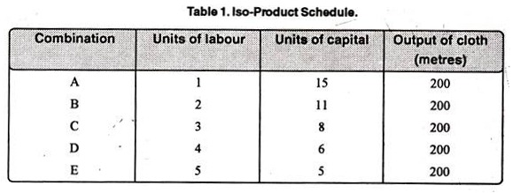
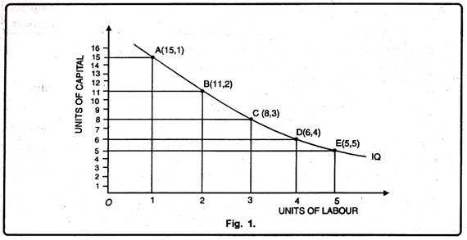

Slide 23
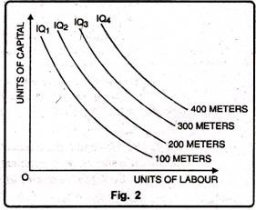
An Iso-quant curve may be defined as a curve showing the possible combinations of two variable factors that can be used to produce the same total product.” Peterson
“Iso-product curve shows the different input combinations that will produce a given output.” Samuelson

Slide 24
Isocosts
Iso means equal and cost means price. i.e., equal price.
Production function for isocost is
TC = (wl) + (rk)
TC = Total cost
W = Wage
L = Labour
R = Cost of capital
K = Capital

Slide 25
An isoquant shows what a firm is desirous of producing. But, the desire to produce a commodity is not enough. The producer must have sufficient capacity to buy necessary factor inputs to be able to reach its desired production level. The capacity of the producer is shown by his monetary resources, i.e., his cost outlay (or how much money he is capable of spending) on capital and labour, the prices of which are taken as constant, i.e., given in the market place.
So, like the consumer the producer has also to operate under a budget (resource) constraint. This is picturised by his budget line called isocost line. To find the least cost combination of inputs to produce a given output, we need to construct such equal cost lines or isocost lines.

Slide 26
An isocost line is a locus of points showing the alternative combinations of factors that can be purchased with a fixed amount of money.
The price of a factor of production is extremely important in this decision.
In order to minimize costs and produce efficiently, the firm must know exactly what its costs will be.

Slide 27
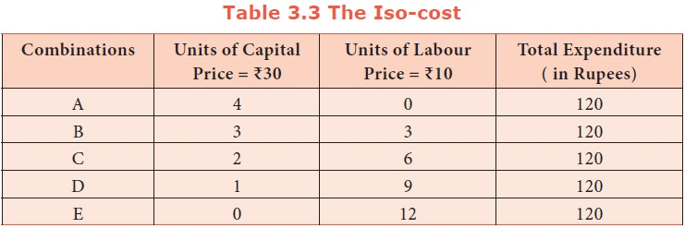
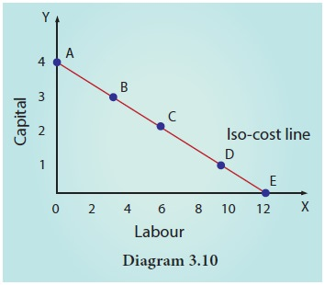

Slide 28
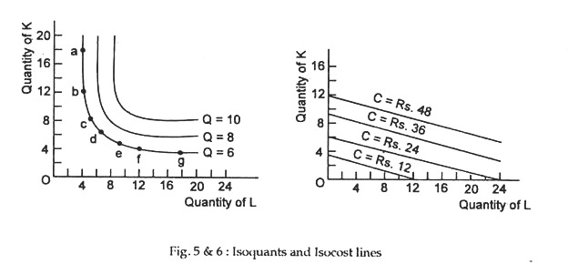
Both isocosts and isoquants are curves plotted on a graph. Used by producers and manufacturers, they display the best interplay of two factors that will result in the maximum output at minimum cost. An isoquant shows all combinations of factors that produce a certain output. An isocost show all combinations of factors that cost the same amount.

Slide 29
Choice of Least Cost Factor combination
In the theory of production, the profit maximisation firm is in equilibrium when, given the cost-price function, it maximises its profits on the basis of the least cost combination of factors.
For this, it will choose that combination which minimizes its cost of production for a given output. This will be the optimal combination for it.

Slide 30
This analysis is based on the following assumptions:
1. There are two factors, labour and capital.
2. All units of labour and capital are homogeneous.
3. The prices of units of labour (w) and that of capital (r) are given and constant.
4. The cost outlay is given.
5. The firm produces a single product.
6. The price of the product is given and constant.
7. The firm aims at profit maximisation.
8. There is perfect competition in the factor market.

Slide 31
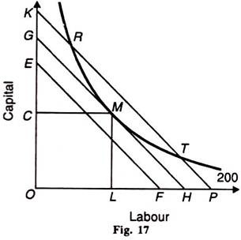
Explanation:
Given these assumptions, the point of least-cost combination of factors for a given level of output is where the isoquant curve is tangent to an iso-cost line. In the Figure, the iso-cost line GH is tangent to the isoquant 200 at point M.
The firm employs the combination of ОС of capital and OL of labour to produce 200 units of output at point M with the given cost-outlay GH. At this point, the firm is minimising its cost for producing 200 units.

Slide 32
Any other combination on the isoquant 200, such as R or T, is on the higher iso-cost line KP which shows higher cost of production. The iso-cost line EF shows lower cost but output 200 cannot be attained with it. Therefore, the firm will choose the minimum cost point M which is the least-cost factor combination for producing 200 units of output.
M is thus the optimal combination for the firm. The point of tangency between the iso-cost line and the isoquant is an important first order condition but not a necessary condition for the producer’s equilibrium.

Slide 33
Law of Returns to Scale
The Law of returns to scale states that if all the four factors of production are increased in a definite proportion (fixed ratio) the resultant marginal productivity increases at a more than proportionate rate for some time, at an equi-proportionate later on and ultimatly at a less than proportionate rate.
Law of returns to scale is also an integrated law consisting of three important laws called as the law of increasing, constant and diminishing marginal returns to scale.
Changing all the factor proportions at a definite rate alters the size or the scales of plant and machinery. The resultant output however increases at an increasing, constant and diminishing rate.

Slide 34
Doses of factors of Production | Marginal Productivity
1 | 10
2 | 15
3 | 20
4 | 20
5 | 20
6 | 15
7 | 10
8 | 5
Law of increasing returns
Law of constant returns to scale
Law of diminishing returns to scale

Slide 35
The additional doses of the inputs are employed and the marginal productivity increased at a more than proportionate rate till the 3rd dose indicating the operation of law of incresing returns to scale.
From the 3rd dose to the 5th dose the marginal returns remained constant there by giving rise to the law of costant marginal returns to scale.
From the 6th dose onwards marginal productivity started diminishing indicating the opertion of the law of diminishing marginal returns to scale.

Slide 36
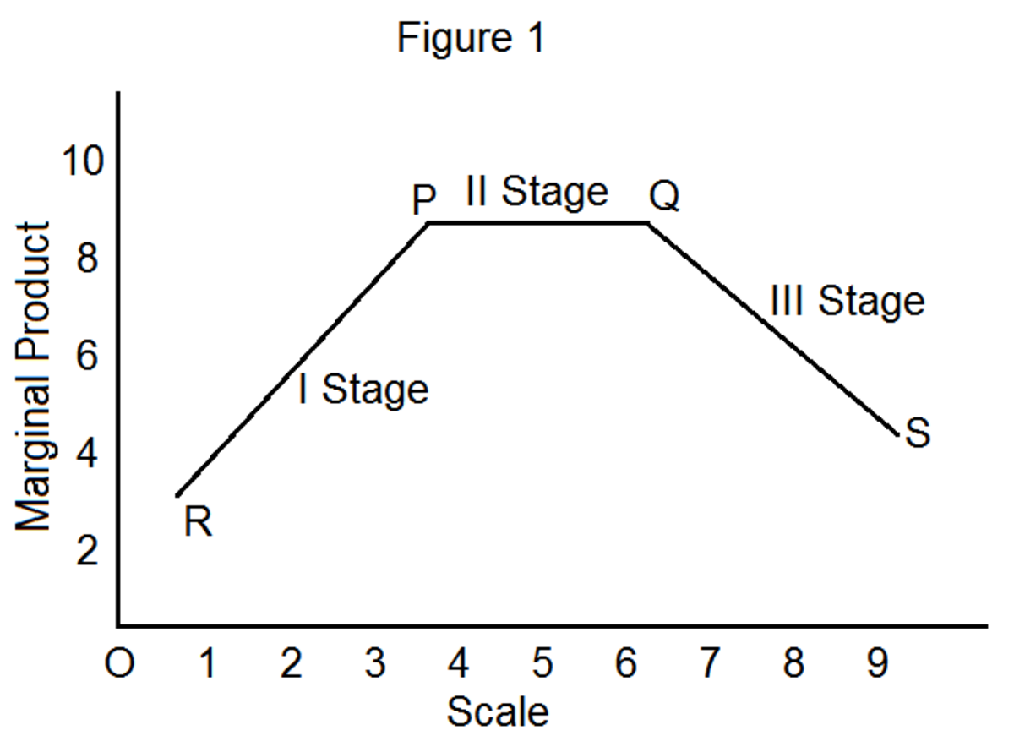
Increasing returns to scale:
If the proportionate increase in the output is more than proportionate increase in the inputs it is said to be increasing returns to scale. It means when we double the inputs the output will be more than double.
Cause for increasing returns:
1. Specialization (or) Division of labour
2. Indivisible factors.
3. Dimensional economics
4. Volume discounts etc.,
Constant returns to scale:
If the proportionate increase in the output and proportionate increase in the inputs are same it is said to be constant returns to scale. It means when we double the inputs the output also will be double. There are no causes for constant returns. It is just an indicator for the ending of increasing returns and
commencement of diminishing returns.
Diminishing returns to scale:
If the proportionate increase in the output is less than proportionate increase in the inputs it is said to be
diminishing returns. It means when we double the inputs the output will be less than double.

Slide 37
Economies of scale
Economies of scale are cost advantages reaped by companies when production becomes efficient. Companies can achieve economies of scale by increasing production and lowering costs.
Economies of scale are an important concept for any business in any industry and represent the cost-savings and competitive advantages larger businesses have over smaller ones.
Economies of scale are cost advantages companies experience when production becomes efficient, as costs can be spread over a larger amount of goods.
A business's size is related to whether it can achieve an economy of scale—larger companies will have more cost savings and higher production levels.
Economies of scale can be both internal and external. Internal economies are caused by factors within a single company while external factors affect the entire industry.

Slide 38
Internal Economies of Scale:
Internal economies of scale are associated with the expansion of the scale of output of the firm; they are derived indirectly as a result of expansion of the industry to which it belongs
Managerial Economies: These economies arise on account of the scope of employing better qualified and trained managers and other employees who are able to take quicker and more profitable decisions. In addition, management experts are exploring new methods of improving the management of the firm and reducing its cost of operations.
Financial Economies: It is a common knowledge that most firms have to depend upon borrowed funds. The lenders, while deciding the rate of interest to be charged on their loans, give due importance to the ‘creditworthiness’ of the borrower. And other things being equal, bigger firms enjoy greater creditworthiness than the smaller one. Accordingly, they are able to borrow funds at lower interest rates. For the same reason, they have also the option of raising additional sources through equity capital.

Slide 39
Technical Economies: With an increase in the scale of output, the choice of inputs and their varieties becomes wider for the firm. It can go in for those machines and equipment etc. which have a higher marginal productivity as compared with their cost. In other words, it is possible to get a larger output per unit of cost incurred on them.
Bye-Products: An increase in the scale of output also generates bigger flows of wastes. When the scale is small, the firm is not able to use these products for additional earnings. However, when the generation of waste crosses a critical limit, it often becomes possible for the firm to produce certain bye-products or sell off the waste to other firms and thus add to its income.
Better Utilization of Inputs: Various inputs, particularly machines and equipment are lumpy and indivisible. They also require time intervals for ‘maintenance’ and ‘servicing’ etc. Any one of them can go out of order and require repairs. If a machine goes out of order, or is otherwise not able to operate, then a firm with a small scale is not able to find its substitute and its production suffers. For example, if a transport company has only one truck and that needs some repair, its employees are left unemployed for the time being, though the firm has to pay them all the while. In contrast, a firm with a bigger scale is able to adjust the availability of its machinery, equipment and employees etc. in such a manner that the ‘downtime’ of various inputs is adequately taken care of.
Economies of Inventories: A bigger-size firm is in a better position to adjust its stocks of inputs and finished products etc. in such a manner that the normal discrepancy between flows of production and sales are ironed out (solved).

Slide 40
Marketing Economies: A large firm also reaps the advantages of buying and selling in bulk. As a result, it is able to procure its inputs at concessional prices. Similarly, on account of bulk selling, its average selling costs come down. It can also have separate sales and marketing departments which can undertake the job of marketing its product in a professional manner. In addition, its sheer size imparts it better bargaining strength.
Advertising: When a firm is not operating under conditions of perfect competition, it is obliged to undertake various activities to promote its sales of which advertising happens to be an integral part. It is found that a small firm is not able to afford advertising because it has to be repetitive to be successful. Moreover, with an increase in the advertising budget, a firm is able to diversify its programme so as to cover more effective media and in an optimum proportion. As a result, its per unit advertising expenses come down.
Risk Economies: A large firm can diversify its product lines and thereby reduce the average risk faced by it since all product lines are not likely to generate losses simultaneously. The firm can compensate its losses from some lines with profits from the others. A large firm has also better command over resources compared with a small firm.

Slide 41
Internal Diseconomies
The firm gets economies only upto a certain level of expansion. If the production base is expanded beyond a limit internal economies may give way to internal diseconomies. Some of these internal diseconomies are
a. Stretching the factors of production beyond their optimal level of operation. When the firm expands beyond the controllable limits, organisational inefficiency sets in. Inefficient management and supervision may result in fall in production or rise in costs.
b. As the number of employees increase leading to misunderstanding.
c. In large departmentalization of work leads to lack of proper coordination and thereby results in duplication of work.
d. Large industrial units often compain the problems created by la our uions puttingup unreasonable demands that impair productive efficiency and increases production costs.

Slide 42
External Economies of Scale:
These economies are those which are reaped by a firm not on account of its own efforts and increase in its scale but on account of the expansion and growth of the industry to which it belongs and also on account of overall development of the economy and markets.
External economies of scale occur outside of an individual company but within the same industry. Remember that in economics, economies of scale mean that the more units a business produces, the less it costs to produce each unit.
External economies of scale describe similar conditions, only for an entire industry instead of a company. For example, if a city creates a better transportation network to service a particular industry, then all companies in that industry will benefit from the new transportation network, and experience decreased production costs.
External economies of scale are business-enhancing factors that occur outside a company but within the same industry.

Slide 43
External Economies of Scale:
Economies of Information: Availability of information is cheaper when we consider the industry as a whole. A firm requires continuous information regarding the prices of inputs and its product, as also likely changes in them on account of shifts in government policies and other developments. If the industry as a whole sets up facilities for providing information through various means of communication, it is much cheaper, than if it is done by the firm alone. As a result, when the authorities or the industry as a whole provides means of information, it becomes economical for the firm to use the same sets up.
Research and Development: The results of research undertaken by the authorities or by the industry as a whole are economical for the firm to use. Also, it is generally commercially viable for a research organisation to undertake research on its own and sell the findings to individual firms on payment basis than for the firms to undertake the same individually.
Economies of Concentration: When an industry is concentrated in a certain locality or region, its firms get incidental saving in costs in the form of cheaper and more reliable services. These services cover, for example, repairs, consultancy, banking, credit, insurance, financial advice, packing, transport, housing, communication, training, housing, health care, and so on. An individual firm is able to make use of these services at competitive and economical prices.
Economies of Specialization: When a number of associated and interlinked industries get located in the neighborhood, they all provide support to each other and their costs come down. As a result, the individual firms also benefit from this development.

Slide 44
External Diseconomies of Scale:
There are several reasons for the prices of inputs to move up or their quality to deteriorate. For example, the authorities may impose a tax on one or more inputs. Or there may be a wage revision in the industry or imposed by the authorities on the economy as a whole.
The expansion of an industry beyond limit may lead to diseconomies such as overcrowding of industrial centers, growth of slums and unhygenic living conditions.
It is also possible that prices of some imported inputs may go up because of one or more reasons including for example, customs duties imposed by the domestic government or by the exporting country or increase in cost of production abroad, etc.
It is possible that on account of war, strikes, some natural calamity, or quantitative restrictions imposed by domestic country or a foreign country, the availability of an essential input may become costlier or insufficient.
There is another danger of the workers forming into a strong union and create labour problems.

Slide 45
Different Cost concepts
MEANING OF COST
It is the expenditure incurred by the producer (or) firm to produce the goods and services.
C = f(Q)
Types of cost:
1. Money:
If the remunerations of the factors of production are paid in the form of money it is called money cost.
For example: rent paid to the land, wages to the labourers etc.
2. Real cost:
The concept of real cost was introduced by Alfred Marshall. Exertions of all kinds of labour that are already indirectly involved in production process. All these efforts and sacrifices together will be called as real cost of production. For example exertions of all kinds of labour, waiting and sacrifices required for saving the capital.

Slide 46
3. Economic costs:
Total expenses incurred by a firm (or) producer in producing a commodity are called economic costs.
These economic costs includes
(a) Explicit costs
(b) Implicit costs
(c) Normal profit.
Explicit costs:
Actual payments made by a firm for purchasing or hiring resources are called explicit costs. These costs are actual money expenses directly incurred for purchasing the resources for example rent to the land, wages to the labourer, expenditure on raw material interest on borrowed money etc.,
Implicit costs:
These costs are imputed costs of the factors of productions owned by the producer himself which are generally left out in the calculation of expenses of the firm. For example rent for the use own land, interest on his own capital etc.
Explicit costs are recorded in the account books but implicit costs are not recorded. Explicit costs are also called “Accounting costs”
Normal profits:
The minimum amount which is required to keep an entrepreneur in the production process is known as normal profit.
Economic cost = Explicit cost + Implicit cost + normal profits

Slide 47
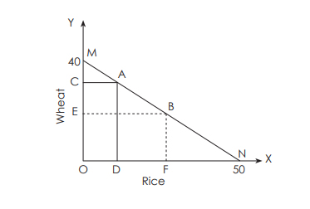
4. Opportunity cost:
The opportunity cost of anything is next best alternative cost which is forgone. Individual point of view (or) nation point of view the resources are scarce. At that time to get the one commodity we have to forgo the another commodity. This is called opportunity costs.
Suppose a price of land can be used for growing wheat or rice. If the land is used for growing rice, it is not available for growing wheat. Therefore the opportunity cost for rice is the wheat crop foregone.
This is illustrated with the help of the following diagram.
Suppose the farmer, using a price of land can b produce either 50 quintals (ON) of rice of 40 quintals (OM) of wheat. If the farmer produced 50 quintals of rice (ON), he cannot produce wheat. Therefore the opportunity cost of 50 quintals (ON) of rice is 40 quintals (OM) of wheat. The farmer can also produce any combination of the two crops on the production possibility curve MN. Let us assume that the farmer is operating at point A on the production possibility curve where he produces OD amount of rice and OC amount of wheat. Now, he decides to operate at point B on the production possibility curve. Here he has to reduce the production of wheat from OC to OE in order to increase the production of rice form OD to OF. It means the opportunity cost of DF amount of rice is the CE amount of wheat

Slide 48
Cost Function:
The cost function explains the functional relationship between cost of production and physical quantity of output.
C = f(Q)
Short run costs:
In the short period cost of production can be divided into two types. They are
1. Fixed costs
2. Variable costs
1. Fixed costs:
The costs which don’t change with change of the output are called fixed costs. It means output may be increase (or) decrease but no change in these costs. Irrespective of the Level of output Quantity the producer must incurr this cost. Even the output is zero the fixed cost is positive. The fixed cost curve (TFC) will be parallel to ox-axis.
Example: expenditure on the land, building, salaries of permanent employees, interest payment, insurance premium etc.

Slide 49
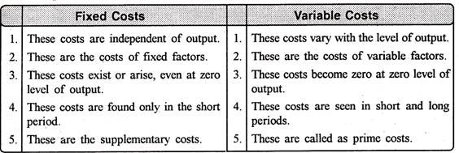
2. Variable costs:
Costs which changed with change of the and output quantity are called variable costs. It means when the output is increased, these costs increased and when the output is decreased, these costs are also decreased. When the output is zero these costs are also zero. The TVC curve will be sloped upwards from “left to right” And it is started from the origin.
Example: Expenditure on raw material, power, fuel, wage of daily laborers etc
3. Total costs:
When the fixed cost are added with variable costs then the total cost can be obtained, when the output increases total costs are also increased and when the output decreases total costs are also decrease. The total cost curve will slope upwards from the left to right as there direct proportional relationship between output and total cost.

